Slide 1
Introduction to Innovative Projects
Final Review

Slide 2
Online Idea-Sourcing Platform
I.D.E.A.Z.oned
-Sanskar Biswal
-16BEC0403

Slide 3
OBJECTIVE
Bring Ideas from Ideators to Innovators who can direct resources to accomplish those Ideas

Slide 4
Abstract
IdeaZoned is intented to be a platform where people, looking for ideas and inspiration can find it via other people on the internet.
The format of the website is similar to that of Github, wherein the user creates a repository of a project that is currently under work. Unlike Github however, IdeaZoned is not restricted to merely programming.
The user chooses which part of the project has to made public and which remains hidden.
Thus, if a user is in need of assistance, he can post a section of the project, stating the problem.
The IdeaZoned community may then read and suggest solutions or provide them altogeather, for free.
The primary developer is simply expected to give appropriate credits to the user provinding a solution.
Thus, an interactive community of idea-sharing will lead to faster development of projects and lead to greater levels of innovation.

Slide 5
The Research Behind I.d.e.a.z.oned
To gauge the feasibility of the concept I conducted a small research on the campus.
This research was conducted during the period of the ‘SELECT MAKE-A-THON’ held from the 27-29th April.
I asked only 4 questions.
Do you always find the right set of resources and skills for projects in the same place?
Do you ever look at the international researches, held back due to lack of break-through and think that perhaps you might have a solution?
Do you use sites like redit.com and stackoverflow.com for aid in your projects?
How likely are the chances of a platform to succeed if it aims to bring the above-stated issues onto a web platform?
The response was to be only in terms of ‘Highly Likely, Possible and Not At All’

Slide 6
The Results
Do you always find the right set of resources and skills for projects in the same place?

Slide 7
The Results
Do you ever look at the international researches, held back due to lack of break-through and think that perhaps you might have a solution?

Slide 8
The Results
Do you use sites like redit.com and stackoverflow.com for aid in your projects?

Slide 9
The Results
How likely are the chances of a platform to succeed if it aims to bring the above-stated issues onto a web platform?

Slide 10
SITE MAP
USER
setting.html
projectview.html
index.html
dashboard.html
publishFile.php
login.php/signup.php
addParticipant.html
publishFile.php
Notes.html/save.php
contact.php
openProject.php
questions.html
search.php
publishProject.php
replyNotes.html
create.php
stats.html/stats.php

Slide 11
WORKING PRINCIPLE
The entire Interface works on the principle of short notes, not exceeding 100 words.
These notes can be linked to each other in the project view, thus helping to form a coherent relation in ideas being developed.
Ideators shall send in solutions in the from of notes. The user can then evaluate the same and either reject the ‘Idea’ or incorporate it into the project

Slide 12
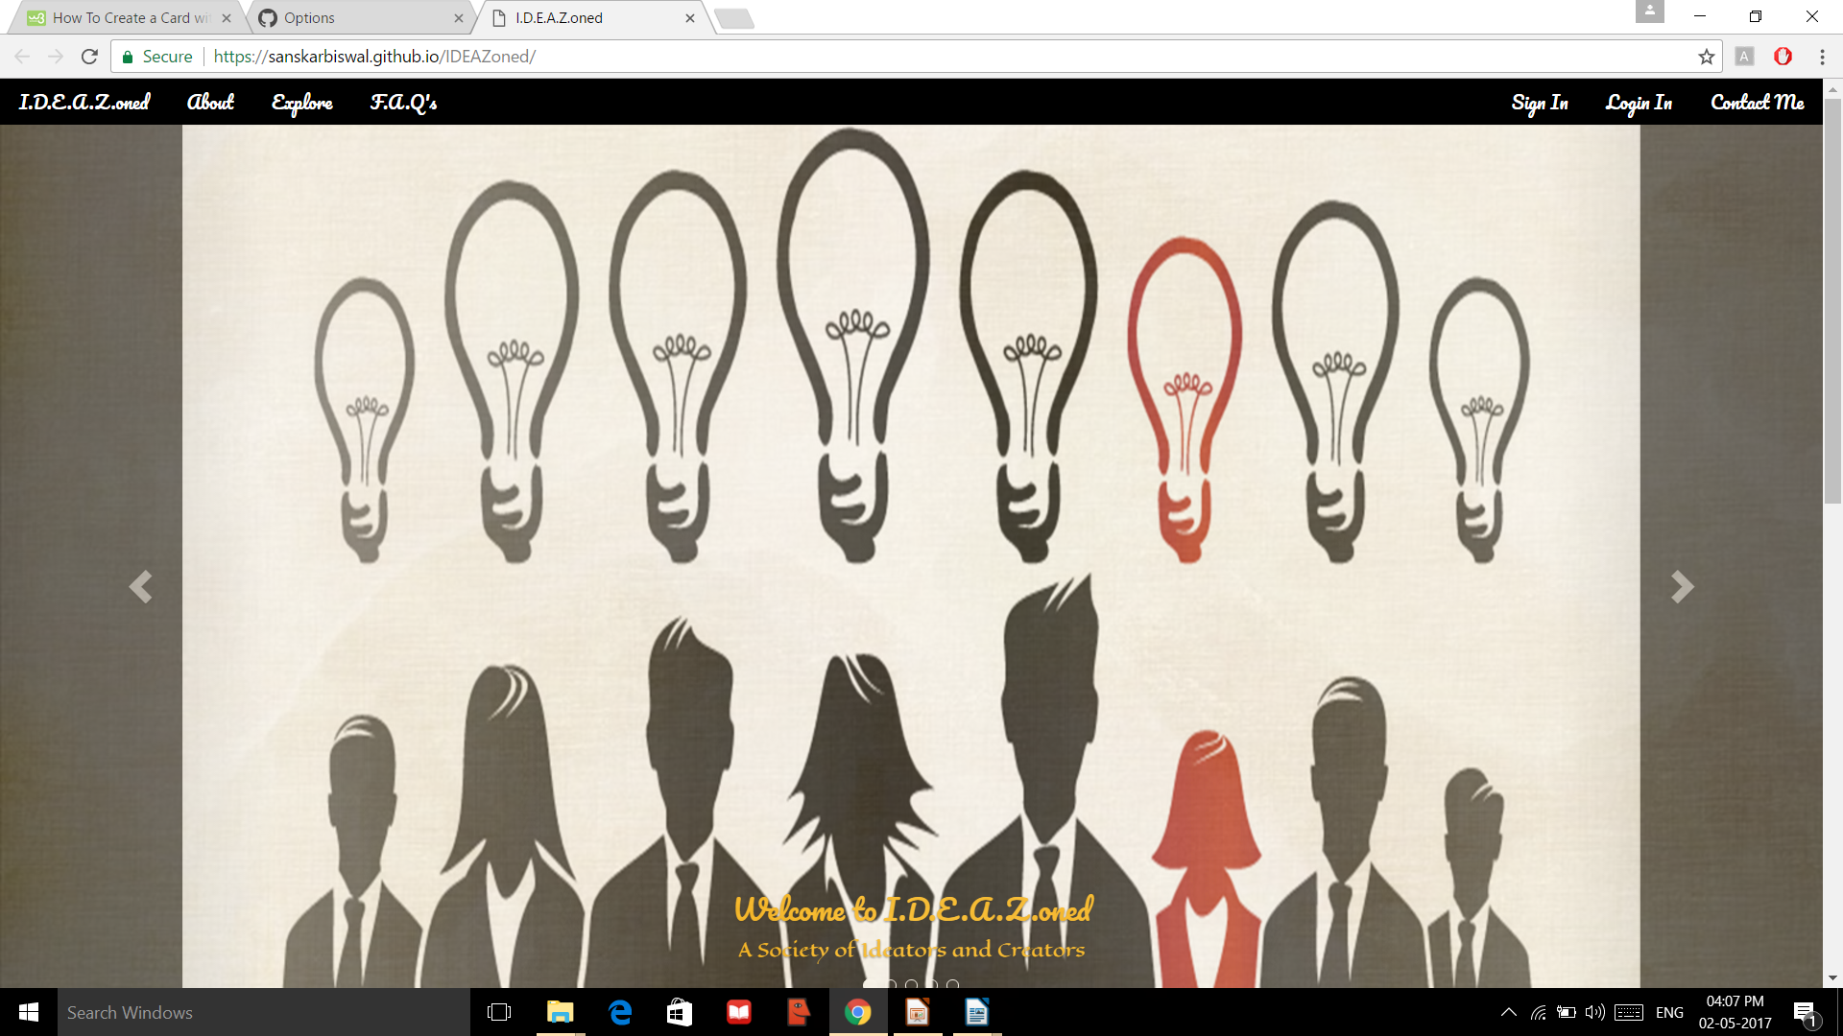
https://sanskarbiswal.github.io/IDEAZoned/

Slide 13
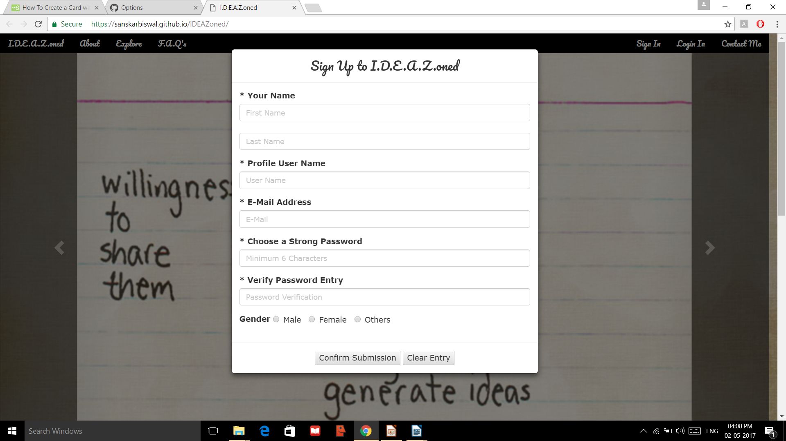

Slide 14
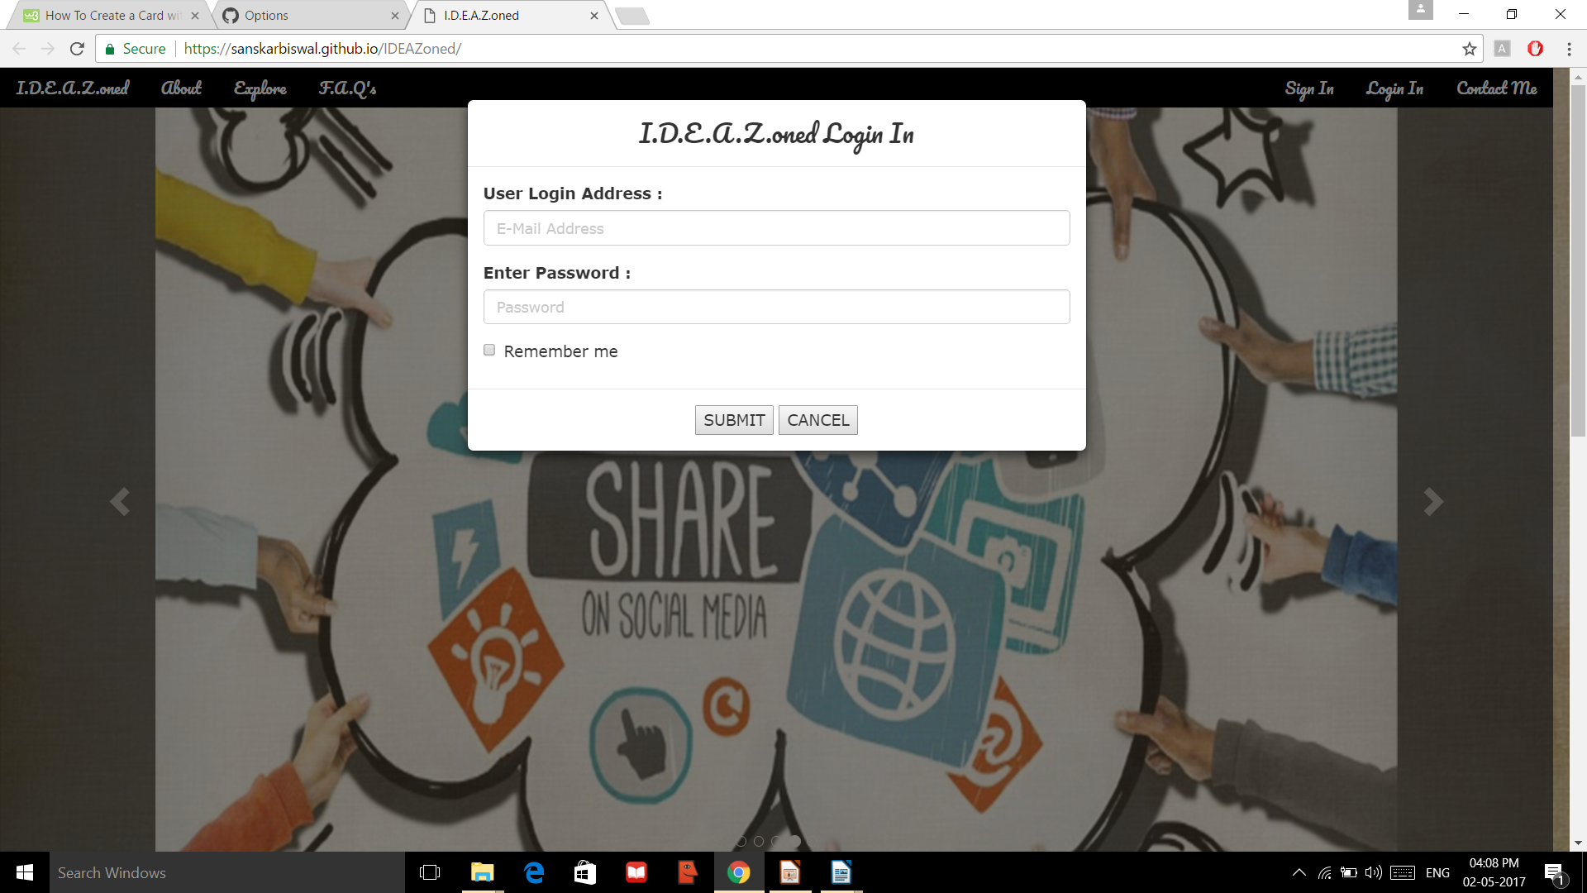

Slide 15
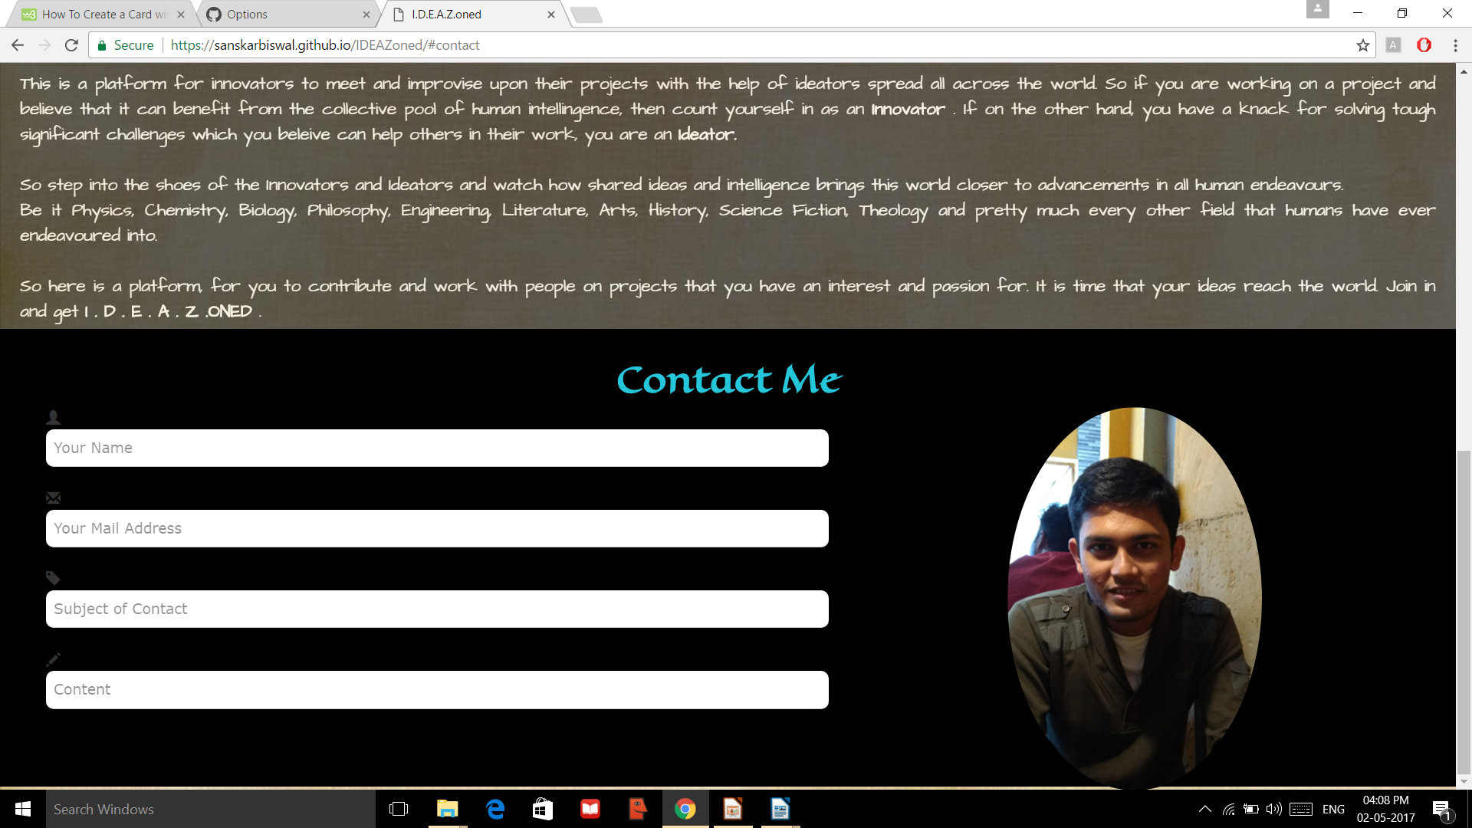

Slide 16
At Present, The Web-site stands frozen.
This Means that The back-end has been removed from the published pages due to data security issues and chances of data-theft.
I expect that the issue will be rectified soon and the site will be up and running soon.

Slide 17
POTENTIAL
Scientists around the world can use this medium to collaborate on research without letting unnecessary spams come into the picture
Artists can use it to share their work and inspirations, thus developing a global art sharing and creation platform
Writers can utilize this medium to publish and gain inspiration for their work
School and College projects can be handled in a more organized and professional manner.
Corporates can use this internally to stimulate nascent creativity of employees
This platform can also be used to croud-write an entire novel or story. Each one unique since there will be different contributors for each line or paragraph or chapter.

Slide 18
THANK YOU

